Slide 1
New Challenges for Virtualization
Siddhartha Gudgunti

Slide 2
Agenda
1
Background
2
Underlying System related Challenges
3
Performance related challenges
4
Management related challenges
5
Challenges in Testing

Slide 3
Background
When > Where >How

Slide 4
Brief Background
1. Utilization
2. Cost Benefit
3. User Experience
Challenges/
Opportunities
Virtual Eco-System (Cloud?)
App
App
App
VM1
VM2
VMn
Host OS (Supporting Virtualization)
Hardware A
Hardware B

Slide 5
Underlying System related challenges
When > Where >How

Slide 6
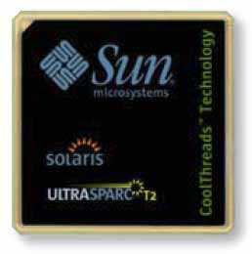
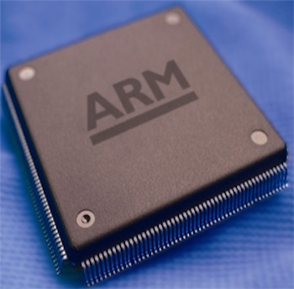
Native System Support
Effective mimicking of existing Native System
Virtualized IA64/SPARC/ARM hardware
These Graphics are Copyright of respective owners.

Slide 7
Native System Dependency
Underlying Hardware support for virtualization
Development of High Availability Hardware system to support Virtualized eco-system
Effective integration of legacy system to the new virtualized eco-system

Slide 8
System Level Security
Host OS support along with actual underlying hardware for effective separation of
Process Space
Data Space
Skepticism by customers of their Data Confidentiality
Storage virtualization has some answers with challenges in performance

Slide 9
Performance related challenges
When > Where >How

Slide 10
Performance
Computing: Processing Power
More powerful processors/solutions around them
Storage: Speed
Data transfer rates between apps
Network: Speed vs. quality
Network choking
Diminishes the End User Experience

Slide 11
Management related challenges
When > Where >How

Slide 12
Infrastructure Management
Consolidation
Energy utilization standards
Optimization
Has DMTF/CIM has geared up to it?

Slide 13
License Management
Validation of License in an ecosystem
Management of huge number of Licenses under such ecosystem
Virtual Eco-System
VirtApp LicenseC
VirtApp LicenseA
VirtApp LicenseB
App LicenseA for Host OSA
App LicenseB for Host OSB
App LicenseC for Host OS-C
Host OS LicenseA
Host OS LicenseB
Host OS LicenseC

Slide 14
IP Authenticity
Transformation of Virtualized environment
Distinguishing factor of an IP depending on a particular property of Virtualized environment
World wide definition of such standardization
Applicability
Uniqueness
Validity

Slide 15
Challenges in Testing
When > Where >How

Slide 16
Testing of Virtual System
Baseline system:
Ecosystem Testing: Large varieties
Virtual CPUs vs. Software As Service
Certification:
Certifying a virtual ecosystem for production
Certification in turn required Benchmarking

Slide 17
Thank You
Siddhartha Gudgunti
Project Manager
Siddhartha.gudgunti@wipro.com

